Slide 1
Computer Organization and Architecture
Subject Code CSE 2151 CREDITS - 04

Slide 2
Computer architecture refers to those attributes of a system visible to a programmer or those attributes that have a direct impact on the logical execution of a program.
Computer organization refers to the operational units and their interconnections that realize the architectural specifications.
Examples of architectural attributes include the instruction set, the number of bits used to represent various data types (e.g., numbers, characters), I/O mechanisms, and techniques for addressing memory.
Organizational attributes include those hardware details transparent to the programmer, such as control signals; interfaces between the computer and peripherals; and the memory technology used

Slide 3
Chapter 1. Basic Structure of Computers

Slide 4
Objectives
The different types of computers
The basic structure of a computer and its
operation
Machine instructions and their execution
Number and character representations
Addition and subtraction of binary numbers

Slide 5
Computer Types
Embedded Computers
  integrated into a larger device or system
  used for a specific purpose
  applications include industrial and home automation, appliances, telecommunication products, and vehicles
Personal computers
  primarily for dedicated individual use
  support a variety of applications such as general computation, document preparation, computer-aided design, audiovisual entertainment, interpersonal communication

Slide 6
Personal computers- Classification
  Desktop computers-serve general needs and fit within a typical personal workspace
  Workstation computers-offer higher computational capacity and more powerful graphical display capabilities
  for engineering and scientific work
  Portable and Notebook computers-
    provide the basic features of a personal computer in a smaller lightweight package.
    can operate on batteries to provide mobility

Slide 7
Servers and Enterprise systems
  large computers that are meant to be shared by a potentially large number of users who access them from some form of personal computer over a public or private network.
  May host large databases and provide information processing for a government agency or a commercial organization

Slide 8
Supercomputers and Grid computers
  most expensive and physically the largest category of computers
  Supercomputers -Used for highly demanding computations needed in weather forecasting, engineering design and simulation, and scientific work.
  high cost
  Grid computers -combine a large number of personal computers disk storage units in a physically distributed high-speed network, called a grid, which is managed as a coordinated computing resource
  cloud computing-users access widely distributed computing and storage server resources for individual, independent, computing needs.
  Internet provides the necessary communication facility.
  Cloud hardware and software service providers operate as a utility, charging on a pay-as-you-use basis.

Slide 9
Functional Units

Slide 10
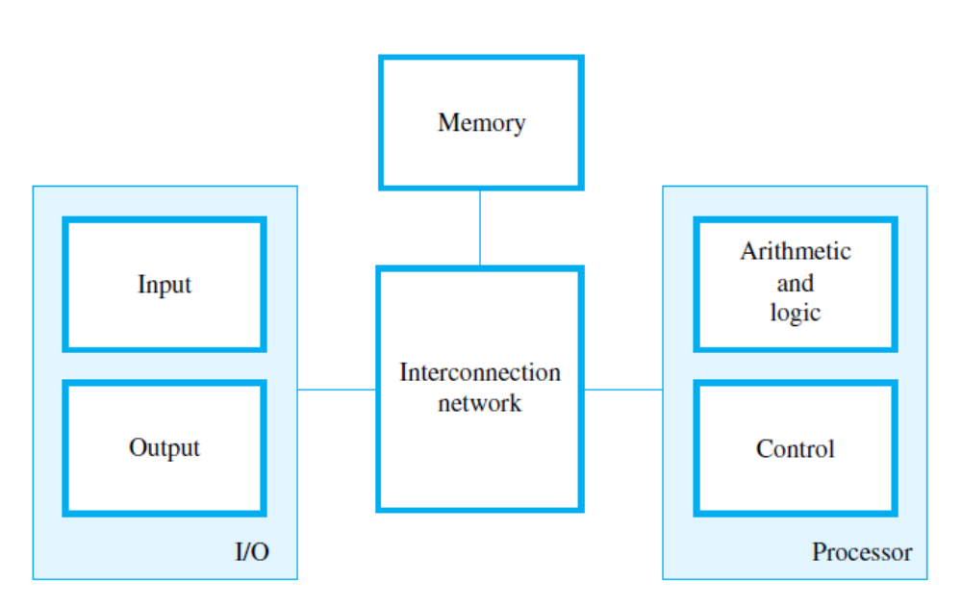

Slide 11
Information Handled by a Computer
Instructions/machine instructions
Govern the transfer of information within a computer as well as between the computer and its I/O devices
Specify the arithmetic and logic operations to be performed
Program-list of instructions which performs a task
Data-
  numbers and characters that are used as operands by the instructions.
Encoded in binary code – 0 and 1

Slide 12
Memory Unit
Store programs and data
Two classes of storage
Primary storage
Fast
Programs must be stored in memory while they are being executed
Large number of semiconductor storage cells capable of storing one bit of information
Processed in words- no.of bits-wordlength
Address-associated with each word location
RAM and memory access time
Secondary storage – larger and cheaper

Slide 13
Cache Memory
  Used to hold sections of a program that are currently being executed, along with any associated data.
  is tightly coupled with the processor and is usually contained on the same integrated-circuit chip.
  facilitates high instruction execution rates.
At the start of program execution, the cache is empty.
As execution proceeds, instructions are fetched into the processor chip, and a copy of each is placed in the cache.
Suppose a number of instructions are executed repeatedly as happens in a program loop and these instructions are available in the cache, they can be fetched quickly during the period of repeated use.
Similarly, if the same data locations are accessed repeatedly while copies of their contents are available in the cache, they can be fetched quickly.
Memory hierarchy – cache, main memory

Slide 14
Secondary Storage
used when large amounts of data and many programs have to be stored, particularly for information that is accessed infrequently.
Access times for secondary storage are longer than for primary memory.
magnetic disks, optical disks (DVD and CD), and flash memory devices.

Slide 15
Input Unit
Computers accept coded information through input units.
The most common input device is the keyboard.
Whenever a key is pressed, the corresponding letter or digit is automatically translated into its corresponding binary code and transmitted to the processor.
Touchpad, joystick, trackball, microphone, camera, internet

Slide 16
Arithmetic and Logic Unit (ALU)
Most computer operations are executed in ALU of the processor.
Load the operands into memory – bring them to the processor – perform operation in ALU – store the result back to memory or retain in the processor.
Registers-high-speed storage elements-store one word of data
Fast control of ALU

Slide 17
Output Unit
send processed results to the outside world.
Graphic display

Slide 18
Control Unit
All computer operations are controlled by the control unit.
The timing signals that govern the I/O transfers are also generated by the control unit.
Control unit is usually distributed throughout the machine instead of standing alone.

Slide 19
Operations of a computer:
Accept information in the form of programs and data through an input unit and store it in the memory
Fetch the information stored in the memory, under program control, into an ALU, where the information is processed
Output the processed information through an output unit
Control all activities inside the machine through a control unit

Slide 20
Basic Operational Concepts

Slide 21
Review
Activity in a computer is governed by instructions.
To perform a task, an appropriate program consisting of a list of instructions is stored in the memory.
Individual instructions are brought from the memory into the processor, which executes the specified operations.
Data to be used as operands are also stored in the memory.

Slide 22
A Typical Instruction
Load R2, LOC
reads the contents of a memory location whose address is represented symbolically by the label LOC and loads them into processor register R2.
The original contents of location LOC are preserved
The original contents of register R2 are overwritten
the instruction is fetched from the memory into the processor. Next, the operation to be performed is determined by the control unit. The operand at LOC is then fetched from the memory into the processor.
Finally, the operand is stored in register R2.

Slide 23
Separate Memory Access and ALU Operation
Add R4, R2, R3
adds the contents of registers R2 and R3, then places their sum into register R4.
The operands in R2 and R3 are not altered, but the previous value in R4 is overwritten by the sum.
They can be transferred to the memory using instructions such as Store R4, LOC
copies the operand in register R4 to memory location LOC.

Slide 24
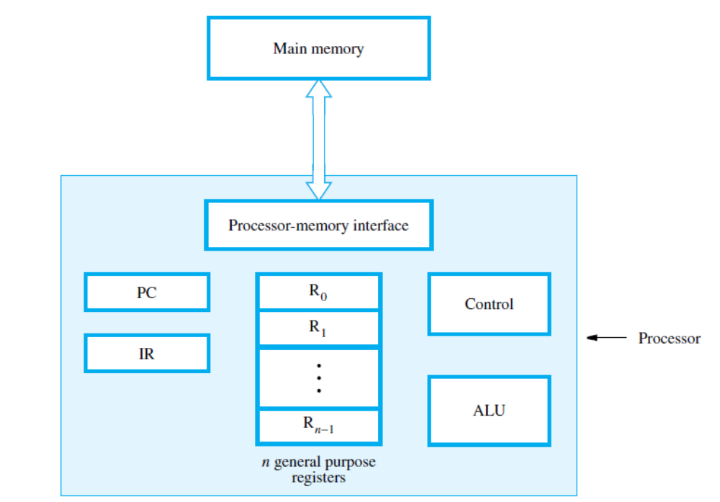
Connection Between the Processor and the Memory

Slide 25
Registers
Instruction register (IR)-holds the instruction that is currently being executed. Its output is available to the control circuits, which generate the timing signals that control the various processing elements involved in executing the instruction
Program counter (PC)-points to the next instruction that is to be fetched from the memory
General-purpose register (R₀ – R_{n-1})

Slide 26
The processor-memory interface is a circuit which manages the transfer of data between the main memory and the processor.
If a word is to be read from the memory, the interface sends the address of that word to the memory along with a Read control signal.
The interface waits for the word to be retrieved, then transfers it to the appropriate processor register.
If a word is to be written into memory, the interface transfers both the address and the word to the memory along with a Write control signal.

Slide 27
Typical Operating Steps
Programs must be in main memory, to be executed
PC is set to point to the first instruction
The contents of PC are transferred to memory unit along with a Read control signal
The first instruction read out is transferred to IR
The instruction is ready to be decoded and executed

Slide 28
Typical Operating Steps (Cont’)
Get operands for ALU
  General-purpose register
  Memory
Perform operation in ALU
Store the result back
  To general-purpose register
  To memory
During the execution, PC is incremented to the next instruction

Slide 29
Interrupt
Normal execution of programs may be preempted if some device requires urgent servicing.
The normal execution of the current program must be interrupted – the device raises an interrupt signal.
Interrupt-service routine
Current system information backup and restore (PC, general-purpose registers, control information, specific information)

Slide 30
Exercise
List the steps needed to execute the machine instruction
Load R2, LOC

Slide 31
Solution
Send the address of the instruction word from register PC to the memory and issue a Read control command.
Wait until the requested word has been retrieved from the memory
load it into register IR, where it is interpreted (decoded) by the control circuitry to determine the operation to be performed.
Increment the contents of register PC to point to the next instruction in memory.
Send the address value LOC from the instruction in register IR to the memory and issue a Read control command.
Wait until the requested word has been retrieved from the memory, then load it into register R2

Slide 32
Repeat for
(i)Add R4, R2, R3
(ii)Store R4, LOC

Slide 33

(a) Give a short sequence of machine instructions for the task “Add the contents of memory location A to those of location B, and place the answer in location C”. Instructions
Load Ri, LOC
and
Store Ri, LOC
are the only instructions available to transfer data between the memory and the general purpose registers. Do not change the contents of either location A or B.

Slide 34
Number, Arithmetic Operations, and Characters

Slide 35
Signed Integer
3 major representations:
Sign and magnitude
One’s complement
Two’s complement
Assumptions:
4-bit machine word
16 different values can be represented
Roughly half are positive, half are negative

Slide 36
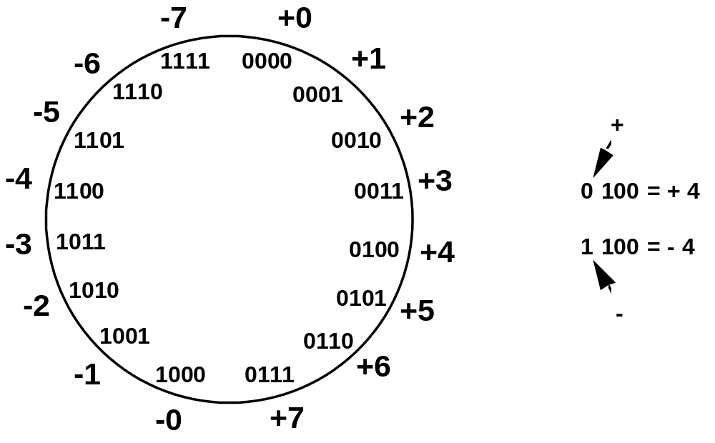
Sign and Magnitude Representation
High order bit is sign: 0 = positive (or zero), 1 = negative
Three low order bits is the magnitude: 0 (000) thru 7 (111)
Number range for n bits = +/-2^{n-1} -1
Two representations for 0

Slide 37
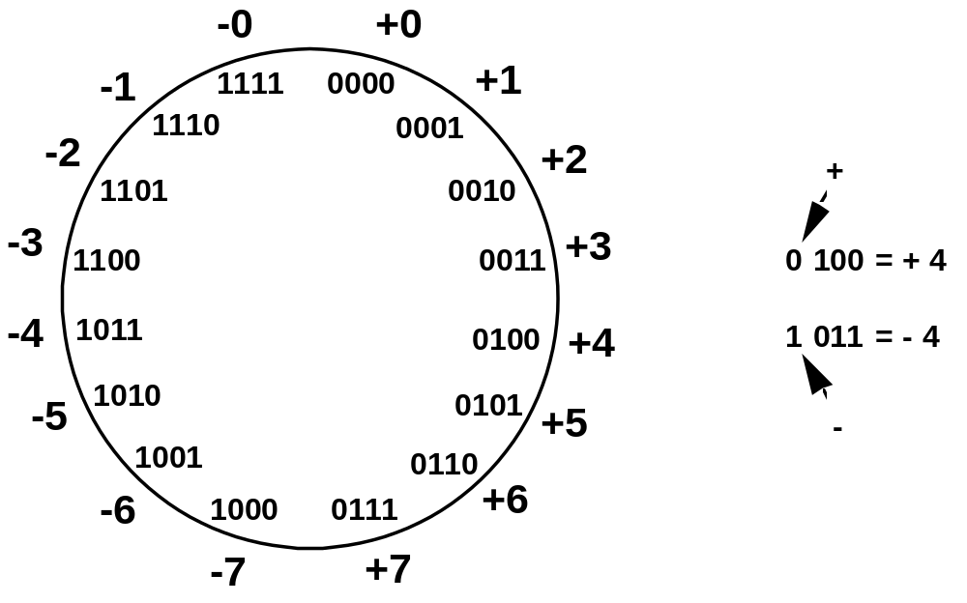
One’s Complement Representation
Subtraction implemented by addition & 1's complement
Still two representations of 0! This causes some problems
Some complexities in addition

Slide 38
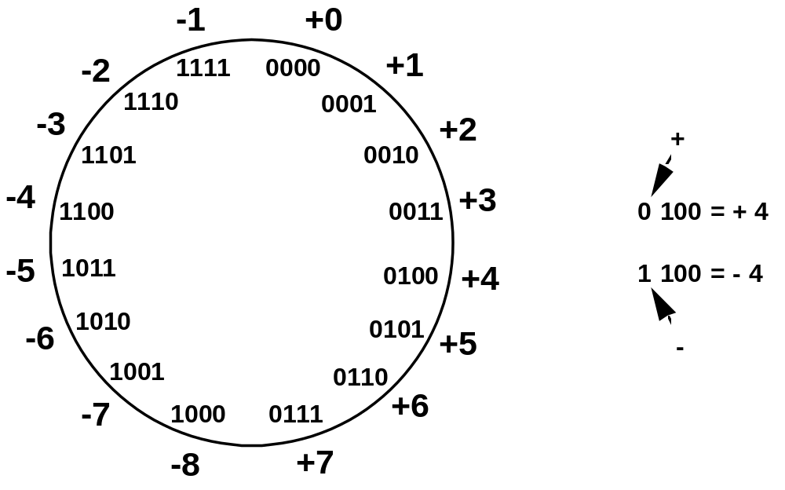
Two’s Complement Representation
like 1's comp
except shifted
one position
clockwise
Only one representation for 0
One more negative number than positive number

Slide 39
Binary, Signed-Integer Representations
B
V
alues represented
Sign and
b
3
b
2
b
1
b
0
magnitude
1'
s complement
2'
s complement
0
1
1
1
+
7
+
7
+
7
0
1
1
0
+
6
+
6
+
6
0
1
0
1
+
5
+
5
+
5
0
1
0
0
+
4
+
4
+
4
0
0
1
1
+
3
+
3
+
3
0
0
1
0
+
2
+
2
+
2
0
0
0
1
+
1
+
1
+
1
0
0
0
0
+
0
+
0
+
0
1
0
0
0
-
0
-
7
-
8
1
0
0
1
-
1
-
6
-
7
1
0
1
0
-
2
-
5
-
6
1
0
1
1
-
3
-
4
-
5
1
1
0
0
-
4
-
3
-
4
1
1
0
1
-
5
-
2
-
3
1
1
1
0
-
6
-
1
-
2
1
1
1
1
-
7
-
0
-
1
Figure 2.1. Binary, signed-integer representations.

Slide 40
Range of numbers represented in 2’s complement representation
4 bits →-8 to +7
5 bits →-16 to +15
6 bits → -32 to +31
n bits→ −2^{n−1} to +2^{n−1} − 1

Slide 41
Addition-Examples
+2+3
+2→ 0010 +
+3→ 0011
+5→ 0101
+4-6
+4→ 0100 +
-6→ 1010
-2→ 1110

Slide 42
Examples
-5-2
-5→ 1011 +
-2→ 1110
-7→ 1001
Carry is ignored
+7-3
+7→ 0111 +
-3→ 1101
+4→ 0100
Carry is ignored

Slide 43
Examples-Subtraction
-3- (-7)
-3→ 1101 - becomes
-7→ 1001
-3→ 1101 +
7→ 0111
+4→ 0100

Slide 44
Examples-Subtraction
+2- (+4)
+2→ 0010 - becomes
+4→ 0100
+2→ 0010 +
-4→ 1100
-2→ 1110

Slide 45
Examples-Subtraction
+6- (+3)
+6→ 0110 - becomes
+3→ 0011
+6→ 0110 +
-3→ 1101
+3→ 0011
Carry is ignored

Slide 46
2’s-Complement Add and Subtract Operations
(a)
0 0 1 0
(
+
2
)
(b)
0 1 0 0
(
+
4
)
+
0 0 1 1
(
+
3
)
+
1 0 1 0
(
-
6
)
0 1 0 1
(
+
5
)
1 1 1 0
(
-
2
)
(c)
1 0 1 1
(
-
5
)
(d)
0 1 1 1
(
+
7
)
+
1 1 1 0
(
-
2
)
+
1 1 0 1
(
-
3
)
1 0 0 1
(
-
7
)
0 1 0 0
(
+
4
)
(e)
1 1 0 1
(
-
3
)
1 1 0 1
-
1 0 0 1
(
-
7
)
+
0 1 1 1
0 1 0 0
(
+
4
)
(f)
0 0 1 0
(
+
2
)
0 0 1 0
-
0 1 0 0
(
+
4
)
+
1 1 0 0
1 1 1 0
(
-
2
)
(g)
0 1 1 0
(
+
6
)
0 1 1 0
-
0 0 1 1
(
+
3
)
+
1 1 0 1
0 0 1 1
(
+
3
)
(h)
1 0 0 1
(
-
7
)
1 0 0 1
-
1 0 1 1
(
-
5
)
+
0 1 0 1
1 1 1 0
(
-
2
)
(i)
1 0 0 1
(
-
7
)
1 0 0 1
-
0 0 0 1
(
+
1
)
+
1 1 1 1
1 0 0 0
(
-
8
)
(j)
0 0 1 0
(
+
2
)
0 0 1 0
-
1 1 0 1
(
-
3
)
+
0 0 1 1
0 1 0 1
(
+
5
)
Figure 2.4. 2's-complement Add and Subtract operations.

Slide 47
Addition and Subtraction – 2’s Complement
To add two numbers, add their n-bit representations, ignoring the carry-out bit from the most significant bit (MSB) position. The sum will be the algebraically correct value in 2’s-complement representation if the actual result is in the range −2^{n−1} through +2^{n−1} − 1.
To subtract two numbers X and Y , that is, to perform X − Y , form the 2’s-complement of Y , then add it to X using the add rule. Again, the result will be the algebraically correct value in 2’s-complement representation if the actual result is in the range −2^{n−1} through +2^{n−1} − 1.

Slide 48
Overflow - Add two positive numbers to get a negative number or two negative numbers to get a positive number
-1
+0
-1
+0
-2
1111
0000
+1
-2
1111
0000
+1
-3
1110
0001
-3
1110
0001
1101
+2
1101
+2
-4
0010
-4
0010
1100
0011
+3
1100
0011
+3
-5
1011
-5
0100
+4
1011
0100
+4
-6
1010
-6
1010
0101
+5
0101
+5
1001
0110
1001
0110
-7
1000
+6
-7
+6
0111
1000
0111
-8
+7
-8
+7
5 + 3 = -8
-7 - 2 = +7

Slide 49
Overflow Conditions
0 1 1 1
0 1 0 1
0 0 1 1
1 0 0 0
1 0 0 0
1 0 0 1
1 1 0 0
1 0 1 1 1
5
3
-8
-7
-2
7
Overflow
Overflow
0 0 0 0
0 1 0 1
0 0 1 0
0 1 1 1
1 1 1 1
1 1 0 1
1 0 1 1
1 1 0 0 0
5
2
7
-3
-5
-8
No overflow
No overflow
Overflow when carry-in to the high-order bit does not equal carry out

Slide 50
Sign Extension
Task:
  Given w-bit signed integer x
  Convert it to w+k-bit integer with same value
Rule:
  Make k copies of sign bit:
  X ′ = x_{w–1} ,…, x_{w–1} , x_{w–1} , x_{w–2} ,…, x₀
w
X
• • •
k copies of MSB
• • •
X ′
• • •
• • •
k
w

Slide 51
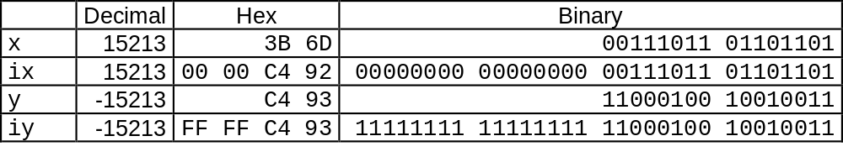
Sign Extension Example
short int x = 15213;
int ix = (int) x;
short int y = -15213;
int iy = (int) y;

Slide 52
Floating-Point Numbers
Binary floating-point number can be represented by:
• a sign for the number
• some significant bits
• a signed scale factor exponent for an implied base of 2

Slide 53
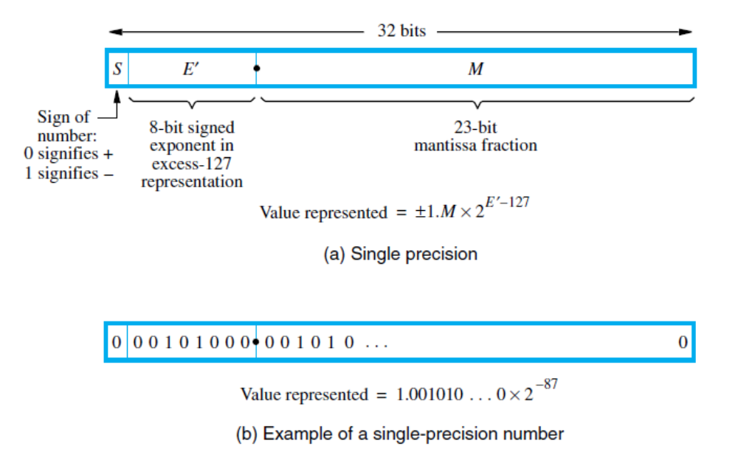
IEEE standard floating-point formats.
Instead of the actual signed exponent, E, the value stored in the exponent field is an
unsigned integer E’= E + 127. This is called the excess-127 format. Thus, E ‘ is in the
range 0 ≤ E’ ≤ 255 where The end values of this range, 0 and 255, are used to represent special values or E, is in the range −126 ≤ E ≤ 127. The scale factor has a range of 2⁻¹²⁶ to 2⁺¹²⁷, which is approximately equal to 10 ^{±38}
Carl Hamacher, ZvonkoVranesic and SafwatZaky, “Computer Organization and Embedded Systems”, Sixth edition, McGraw Hill Publication, 2012

Slide 54
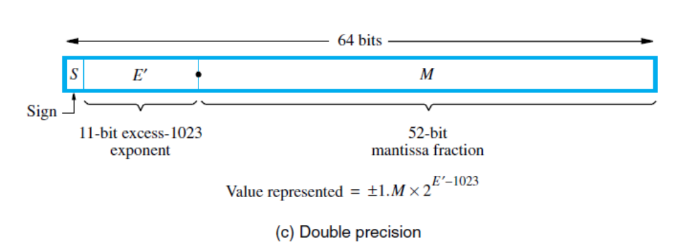
The 11-bit excess-1023 exponent E’ has the
range 1 ≤ E’ ≤ 2046 for normal values, with 0 and 2047 used to indicate special values,
Thus, the actual exponent E is in the range −1022 ≤ E ≤ 1023 providing scale
factors of 2⁻¹⁰²² to 2¹⁰²³ (approximately 10 ^{±308})
Carl Hamacher, ZvonkoVranesic and SafwatZaky, “Computer Organization and Embedded Systems”, Sixth edition, McGraw Hill Publication, 2012

Slide 55
The full 24-bit string, B, of significant bits, called the
mantissa, always has a leading 1, with the binary point immediately to its right
The mantissa
B = 1.M = 1.b₋₁b₋₂ . . . b₋₂₃
has the value
V(B) = 1 + b₋₁ × 2⁻¹ + b₋₂ × 2⁻² +・ ・ ・+b₋₂₃ × 2⁻²³
when the binary point is placed to the right of the first significant bit, the number is said to be normalized. Note that the base, 2, of the scale factor and the leading 1 of the mantissa are both fixed. They do not need to appear explicitly in the representation.

Slide 56
Special values
When E’ = 0 and the mantissa fraction M is zero, the value 0 is represented. When
E’ = 255 and M = 0, the value ∞ is represented
When E ‘= 0 and M not equal to 0, denormal numbers are represented. Their value is ±0.M ×2⁻¹²⁶
  There is no implied one to the left of the binary point, and M is any nonzero 23-bit fraction
When E’ = 255 and M not equal to 0, the value represented is called Not a Number (NaN). A NaN represents the result of performing an invalid operation such as 0/0 or √−1.

Slide 57
Exceptions
In conforming to the IEEE Standard, a processor must set exception flags if any of the following conditions arise when performing operations: underflow, overflow, divide by zero, inexact, invalid
Inexact is the name for a result that requires rounding in order to be represented in one of the normal formats.
An invalid exception occurs if operations such as 0/0 or√−1 are attempted. When an exception occurs, the result is set to one of the special values.

Slide 58
Add/Subtract Rule
1. Choose the number with the smaller exponent and shift its mantissa right a number of steps equal to the difference in exponents.
2. Set the exponent of the result equal to the larger exponent.
3. Perform addition/subtraction on the mantissas and determine the sign of the result.
4. Normalize the resulting value, if necessary.

Slide 59
Multiply Rule
1. Add the exponents and subtract 127 to maintain the excess-127 representation.
2. Multiply the mantissas and determine the sign of the result.
3. Normalize the resulting value, if necessary.

Slide 60
Divide Rule
1. Subtract the exponents and add 127 to maintain the excess-127 representation.
2. Divide the mantissas and determine the sign of the result.
3. Normalize the resulting value, if necessary.

Slide 61
Character Representation
The most common encoding scheme for characters is ASCII
8-bit byte is used to represent and store a character
The code occupies the low-order seven bits
The high-order bit is usually set to 0.

Slide 62
Addition example-decimal
example on decimal value given in scientific notation:
3.25 x 10 ** 3
+ 2.63 x 10 ** -1
-----------------
first step: align decimal points
second step: add
3.25 x 10 ** 3
+ 0.000263 x 10 ** 3
--------------------
3.250263 x 10 ** 3
third step: normalize the result (already normalized!)

Slide 63
Convert the decimal numbers to floating point binary
A=96.625
1100000.101
After normalizing we get
1.100000101 X 2⁶
E’= 6+127=133
=10000101
In IEEE 32 bit format
01000010110000010100000…….
B=12.125
1100.001
After normalizing we get
1.100001 X 2³
E’= 3+127=130
=10000010
In IEEE 32 bit format
01000001010000100000……

Slide 64
Step 1:
Choose the number with the smaller exponent and shift its mantissa right a number of steps equal to the difference in exponents.
A=0 10000101 10000010100000…….
B=0 10000010 10000100000……
Shift the mantissa of smaller number to the right by 3 bits we get
1.10000100000 ---Original manntissa (with hidden bit considered)
0.11000010000 ---shifting by 1 bit
0.011000010000---shifting by 2 bits
0.001100001000 --shifting by 3 bits
Step 2: Set the exponent of the result equal to the larger exponent
10000101

Slide 65
Step 3:
Perform addition on the mantissas and determine the sign of the result
1.100000101000000
0.001100001000000
1.101100110000000
Step 4:Normalize the resulting value, if necessary
Result is already normalized
In 32 bit format
0 10000101 101100110000
Which is 108.75 in decimal

Slide 66

Subtraction- Same example
First two steps are same , so not shown here
Step 3:
Perform subtraction on the mantissas and determine the sign of the result 1.10000010100000
0.00110000100000
1.01010010000000
Step 4:Normalize the resulting value, if necessary
Result is already normalized
In 32 bit format
0 10000101 010100100000000
which is 84.5 in decimal

Slide 67
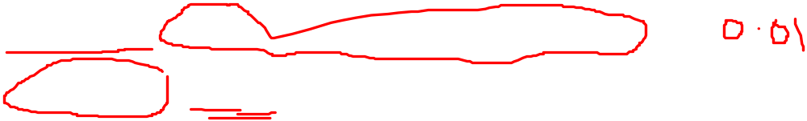
Addition example- binary
.25 = 0 01111101 00000000000000000000000
100 = 0 10000101 10010000000000000000000
to add these fl. pt. representations,
step 1: align radix points
shifting the mantissa LEFT by 1 bit DECREASES THE EXPONENT by 1
shifting the mantissa RIGHT by 1 bit INCREASES THE EXPONENT by 1
we want to shift the mantissa right, because the bits that
fall off the end should come from the least significant end of the mantissa
-> choose to shift the .25, since we want to increase it's exponent.
-> shift by 10000101
-01111101
---------
00001000 (8) places.

Slide 68
Example Contd…
00000000000000000000000 (original value)
10000000000000000000000 (shifted 1 place)
(note that hidden bit is shifted into msb of mantissa)
01000000000000000000000 (shifted 2 places)
00100000000000000000000 (shifted 3 places)
00010000000000000000000 (shifted 4 places)
00001000000000000000000 (shifted 5 places)
00000100000000000000000 (shifted 6 places)
00000010000000000000000 (shifted 7 places)
00000001000000000000000 (shifted 8 places)

Slide 69
Example Contd..
add (don't forget the hidden bit for the 100)
1.10010000000000000000000 (100)
0.00000001000000000000000 (.25)
---------------------------------------
1.10010001000000000000000
step 3: normalize the result (get the "hidden bit" to be a 1)
it already is for this example. result is
0 10000101 10010001000000000000000

Slide 70

Example- Multiplication
0 10000100 0100
x 1 00111100 1100
-----------------
mantissa multiplication: 1.0100
(don't forget hidden bit) x 1.1100
------
00000
00000
10100
10100
10100
---------
1000110000
becomes 10.00110000

Slide 71

Example Contd…
Step 1: add exponents and subtract 127
exponent of result is 132+60-127=65.
unsigned representation for 65 is 01000001.
Step 2: Multiply the mantissa
10.00110000
normalize the result:
(moving the radix point one place to the left increases
the exponent by 1.)
10.00110000
becomes
1.000110000 X 2¹
Step 3: Adjust the exponent : 65+1=66
this is the value stored (not the hidden bit!):
1 01000010 000110000

Slide 72

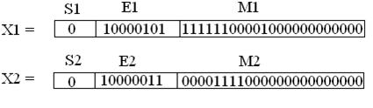
Example-Division
X1=127.03125
X2=16.9375
In binary
X1=1111111.00001
X2=10000.1111
After normalization
X1=1.11111100001 X 2⁶
X2=1.00001111 X 2⁴
Excess 127 exponents of X1 and X2 are 127+6=133
127+4=131 respectively
Equivalent floating point binary words are
0 10000101 11111100001
0 10000011 00001111000
That is

Slide 73
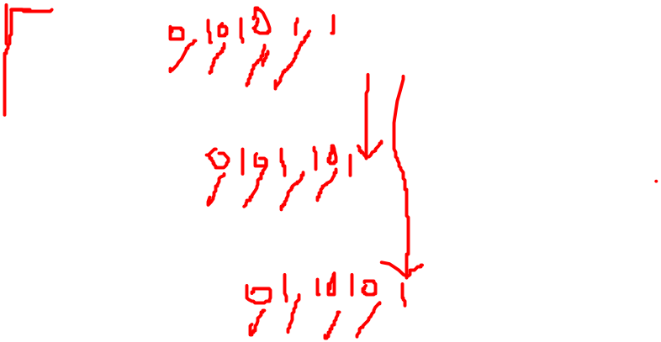

Example Contd…
Step 1:Subtract the exponents and add 127
exponent of result is 133-131+127 => 129 => (10000001)
Step 2: Divide the mantissa
1.1 1 1____________
1.00001111 | 1.1 1 1 1 1 1 0 0 0 0 1
1.0 0 0 0 1 1 1 1
0 1 1 1 0 1 1 0 1 0
1 0 0 0 0 1 1 1 1
0 1 1 0 0 1 0 1 1 0
1 0 0 0 0 1 1 1 1
0 1 0 0 0 0 1 1 1 1
1 0 0 0 0 1 1 1 1
0 0 0 0 0 0 0 0 0

Slide 74

Step 3: Normalize the result
The result is already normalized.
Putting the result in IEEE 32 bit format, we get
0 10000001 11100000000…….
That is
X3 in decimal = 7.5

Slide 75
Multiplication Example
A=96.625
1100000.101
After normalizing we get
1.100000101 X 2⁶
E’= 6+127=133
=10000101
In IEEE 32 bit format
01000010110000010100000…….
B=12.125
1100.001
After normalizing we get
1.100001 X 2³
E’= 3+127=130
=10000010
In IEEE 32 bit format
01000001010000100000……

Slide 76
Step 1: add exponents and subtract 127
exponent of result is 133+130-127=136
unsigned representation for 136 is 10001000.
Step 2: Multiply the mantissa
1.100000101 x 1.100001
-----------------------------
mantissa multiplication: 1.100000101
x 1.100001
------------------------

Slide 77

1.100000101 x 1.100001
-----------------------------
mantissa multiplication: 1.100000101
x 1.100001
------------------------
1 1 0 0 0 0 0 1 0 1
0 0 0 0 0 0 0 0 0 0 X
0 0 0 0 0 0 0 0 0 0 X X
0 0 0 0 0 0 0 0 0 0 X X X
0 0 0 0 0 0 0 0 0 0 X X X X
1 1 0 0 0 0 0 1 0 1 X X X X X
1 1 0 0 0 0 0 1 0 1 X X X X X X
--------------------------------------------
1 0 .0 1 0 0 1 0 0 1 1 1 0 0 1 0 1
After normalizing we get 1.0010010011100101 X 2¹

Slide 78
Step 3: Adjust the exponent : 136+1=137→ 10001001
In 32 bit representation, it is
0 10001001 0010010011100101
= 1.0010010011100101 X 2¹⁰
^{=10010010011.100101}
=1024+128+16+2+1. 0.5+.0625+.015625
^{=1171.578125}

Slide 79
Division Example
A=97.0
1100001.0
After normalizing we get
1.100001 X 2⁶
E’= 6+127=133
=10000101
In IEEE 32 bit format
01000010110000100…….
B=12.125
1100.001
After normalizing we get
1.100001 X 2³
E’= 3+127=130
=10000010
In IEEE 32 bit format
01000001010000100000……

Slide 80
Step 1: add exponents and subtract 127
exponent of result is 133-130+127=130
unsigned representation for 136 is 10000010
Step 2: Divide the mantissa
1.100001 / 1.100001
1._0___________
1.100001 | 1.1 0 0 0 0 1 1 1 0 0 0 0 1
0 0 0 0 0 0 0
Step 3: Normalize the result
The result is already normalized.
Putting the result in IEEE 32 bit format, we get
0 10000010 00000000000…….
That is 1.0 X2³ = 1000 =8 in decimal

Slide 81
Guard Bits and Truncation
Mantissas of initial operands and final results are limited to 24 bits, including the implicit leading 1
To attain maximum accuracy in the final results it is important to retain extra bits, often called guard bits, during the intermediate steps.
Removing guard bits in generating a final result requires that the extended mantissa be truncated to create a 24-bit number that approximates the longer version.

Slide 82

Ways of truncation chopping
remove the guard bits and make no changes in the retained bits
e.g. To truncate from 6 bits to 3 bits
0.b₋₁b₋₂b₋₃000 to 0.b₋₁b₋₂b₋₃ 111 are truncated to 0.b₋₁b₋₂b₋₃
The error in the 3-bit result ranges from 0 to 0.000111
the error in chopping ranges from 0 to almost 1 in the least significant position of the retained bits.
In our example, this is the b₋₃ position. The result of chopping is a biased approximation because the error range is not symmetrical about 0

Slide 83
Von Neumann rounding
If the bits to be removed are all 0s, they are simply dropped, with no changes to the retained bits.
If any of the bits to be removed are 1, the least significant bit of the retained bits is set to 1
all 6-bit fractions with 0.b₋₄b₋₅b₋₆ not equal to 000 are truncated to 0.b₋₁b₋₂1
The error in this truncation method ranges between −1 and +1 in the LSB position of the retained bits
approximation is unbiased because the error range is symmetrical about 0.
When three guard bits are used, using Von Neumann Rounding, the value 0.001100 is truncated to 0.001

Slide 84
Rounding
achieves the closest approximation to the number being truncated and is an unbiased technique.
A 1 is added to the LSB position of the bits to be retained if there is a 1 in the MSB position of the bits being removed.
Thus, 0.b₋₁b₋₂b₋₃1. . . is rounded to 0.b₋₁b₋₂b₋₃+ 0.001, and 0.b₋₁b₋₂b₋₃0. . . is rounded to 0.b₋₁b₋₂b₋₃.
except for the case in which the bits to be removed are 10 . . . 0.
This is a tie situation; the longer value is halfway between the two closest truncated representations.
When three guard bits are used, using Rounding procedure, the value 0.001100 is truncated to 0.010

Slide 85
0.111 011=0.111
0.110 011=0.110
0.111 101=0.111+0.001=1.000
0.111 100=0.111+0.001=1.000
0.110 100=0.110
0.101 100=0.101+0.001=0.110

Slide 86

To break the tie
choose the retained bits to be the nearest even number
the value 0.b₋₁b₋₂0100 is truncated to the value 0.b₋₁b₋₂0, and 0.b₋₁b−₂1100 is truncated to 0.b₋₁b₋₂1 + 0.001.
Also termed as “round to the nearest number or nearest even number in case of a tie”
The error range is approximately −1/2 to +1/2 in the LSB position of the retained bits.
best method.
most difficult to implement because it requires an addition operation
and a possible renormalization. This rounding technique is the default mode for truncation specified in the IEEE floating-point standard

Slide 87
Implementing Rounding
Implementing rounding requires only three guard bits to be carried along during the intermediate steps in performing an operation.
The first two of these bits are the two most significant bits of the section of the mantissa to be removed. The third bit is the logical OR of all bits beyond these first two bits in the full representation of the mantissa.
It should be initialized to 0. If a 1 is shifted out through this position while aligning mantissas, the bit becomes 1 and retains that value; hence, it is usually called the sticky bit.

Slide 88

When three guard bits are used, using Rounding procedure, the value 0.001100 is truncated to 0.010

Slide 89
Reference
Carl Hamacher, ZvonkoVranesic and SafwatZaky, “Computer Organization and Embedded Systems”, Sixth edition, McGraw Hill Publication, 2012.

